Slide 1

Amazon sales analysis capstone project

Slide 2
Contents
Purpose of the project and overview and scope
Objective
Business problem
Project diagram
Data collection and understanding
Data information
Data dictionary
Project sales, trends, and customer insights
Collected Screenshot Data
Created Videos
Recommendation

Slide 3
Purpose , overview and scope of the project
The main goal of this project is to gain understanding from amazon sales data, exploring the various factors that influence sales across different branches.
This involves a comprehensive analysis of a company sales data to understand product performance, customer behaviour and sales trends.The project will entill detail preprocessing and explotary data analysis to extract insights with the goal of delivering a standerd recommendation that enable the company to optimize the sales strategies,enhance customer satisfaction and bright growth.

Slide 4
Objective
The main objective of this Amazon sales analysis project is to gain insights into sales data to identify factors affecting sales across different branches, enabling the development of strategies to optimize sales performance and improve overall business outcomes.

Slide 5
Business Problem
The company faces a major challenge in sales across three different cities and improving customer satisfaction in the compettive e_commerce market by the necessity to graspthe diverse factors impacting sales three unique branches

Slide 6
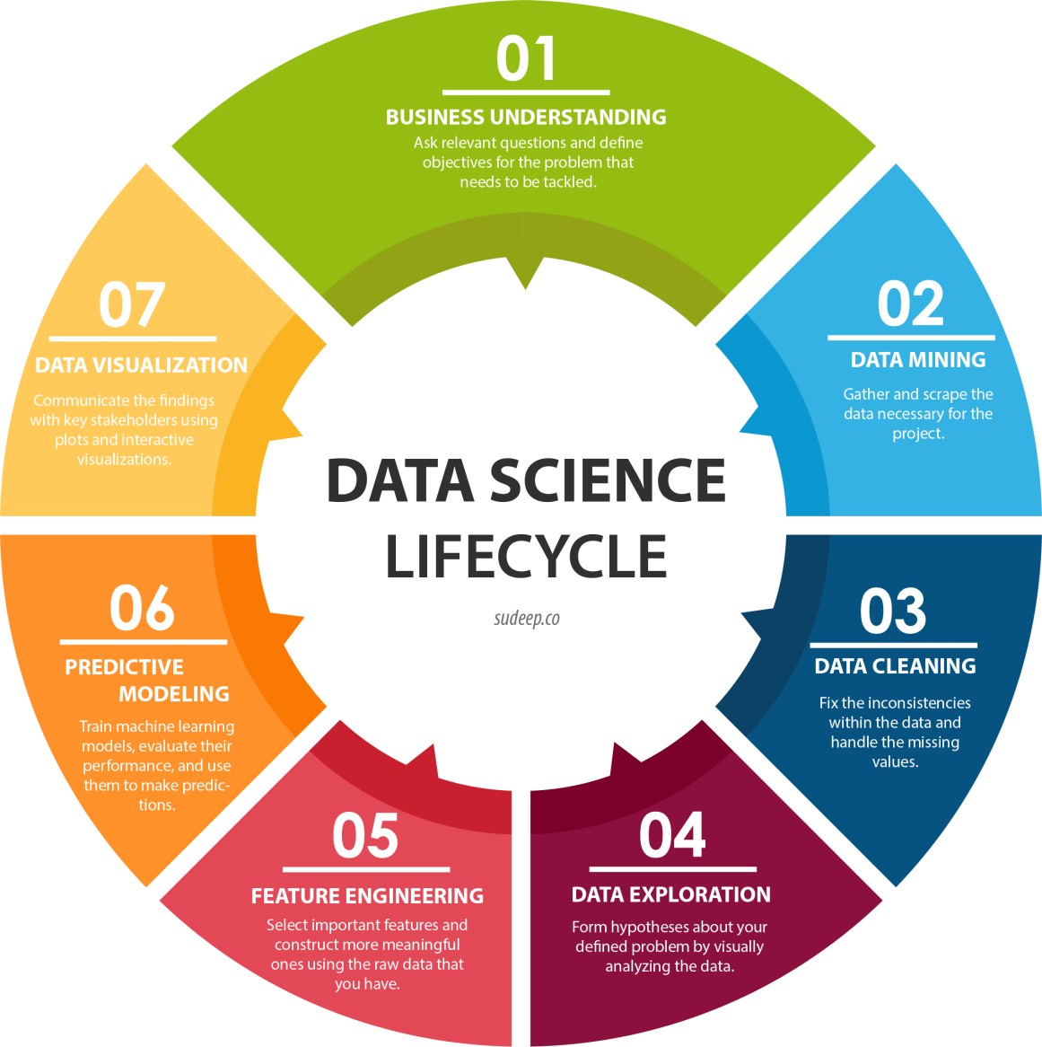
Project Diagram

Slide 7
Data Collection And Understanding
Data collection:
Used the primary data and importing to excel.
Data dictionary:
Here is the list of the column names:
Invoice_ID ,Branch , City Customer_type, Gender , Product_line , Unit_price , Quantity, Tax_pct , Total , Date , Time , Payment , cogs , gross_margin_percentage , gross
_income , Rating .
Data dimensions:
Here are 17 columns and 1000 rows.
Added three extra columns for clean analysis
day-name, month_name,time_of_day.

Slide 8
Insights of sales data of amazon
Insights of product analysis:
Food and beverages are high demand as per sales and avg rating is 7.11.
Fashion accessories are 2nd highest leading product as per sales and avg rating is 7.03.
Health and beauty are 3rd leading product as per sales
Compare to all of the products homes and life
style are lowest sales as per rating.

Slide 9
Insights Of Sales Data Of Amazon
Insights of sales analysis:
Most of the sales afternoon Wednesday occurred
Naypyitaw city has generated more revenue compare to other citites.
In the month of january cost of goods solds at its peak

Slide 10
Insights Of Sales Data Of Amazon
Insights of customer analysis:
Most products ordered by female customers compare to male customers.
Customer type member has more revenue generated compare to normal type.

Slide 11
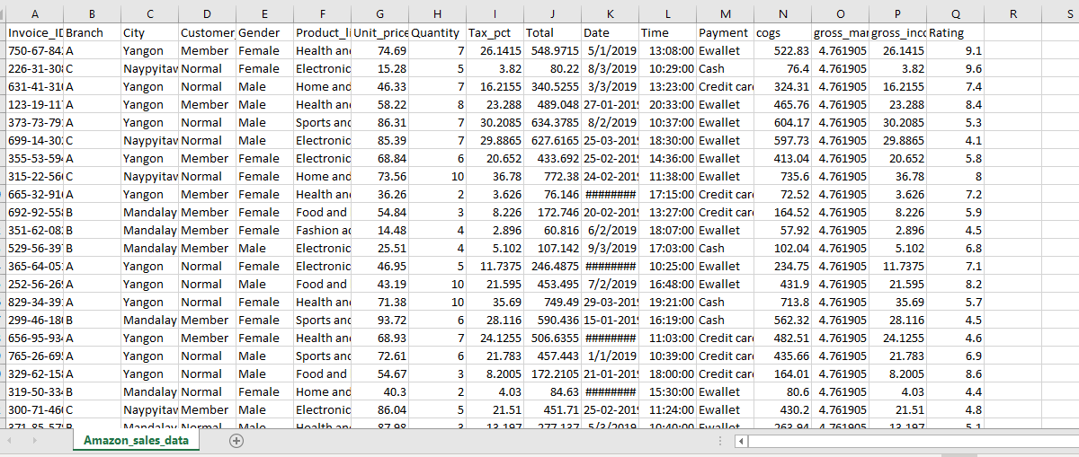
Screenshort Collected Data

Slide 12
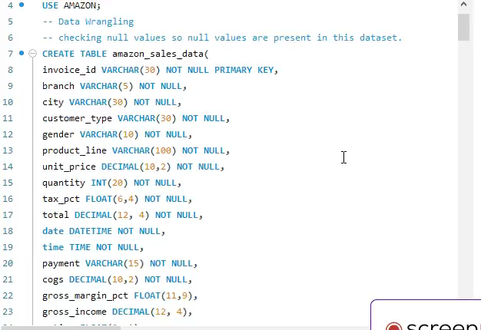
Created Video

Slide 13
Business Recommendation
Focus on high-demand categories like food, fashion, and beauty while improving low-performing home products. Target Wednesday afternoons and Naypyitaw with tailored promotions. Leverage female customer preferences and encourage membership upgrades. Optimize for seasonal peaks like January. Implement feedback loops for continuous improvement to enhance sales strategies, customer satisfaction, and overall growth.
Invest in product quality improvements,discount some products in odd days and occassion also. please chceking products and its durability and some other factors it might be help to grow the business of the company.

Slide 14


